Slide 1
Midterm - Object Detection Project Group 4
Kaire Campomanes
Dallas Foster
Elijah Ghaya
Hisham Macaraya
Katherine Stanton

Slide 2
Project goal: To enhance an object detection model’s performance
Introduction
This report/presentation details the methods used to enhance the performance of an object detection model using the VGG16 pre-trained model. The experiment involved fine-tuning the model by freezing different numbers of layers and evaluating the impact on performance. The performance metrics were compared to a baseline model to assess improvements.

Slide 3



GitHub Rerpository for This Project
ktgraze/ITAIMidtermGroup4
This Photo by Unknown Author is licensed under CC BY

Slide 4
Methodology
Dataset Selection and Preparation:
Dataset: Oxford-IIT Pet Dataset, which contains images of 37 pet breeds.
Preprocessing: Images were resized to 224x224 pixels and normalized to the range [0, 1].
One-Hot Encoding: Labels were one-hot encoded to match the output format of the model.
2. Data Augmentation:
ImageDataGenerator: Used to apply random transformations such as rotation, width shift, height shift, horizontal flip, brightness adjustment, zoom, shear, and channel shift to create more diverse training examples.
3. Model Architecture:
Base Model: VGG16 pre-trained on ImageNet, with the top layers removed.
Custom Top Layers: Added a Flatten layer followed by a Dense layer with softmax activation to classify the 37 pet breeds.
4. Fine-Tuning:
Experiment: Conducted three training runs with different numbers of layers frozen in the VGG16 model: a.) Freezing the first 10 layers, b.) Freezing the first 5 layers, and c.) Freezing the first 15 layers.

Slide 5
Methodology continued…
Training:
Optimizer: Adam optimizer
Loss Function: Categorical cross-entropy
Metrics: Accuracy
Callbacks: Model Checkpoint to save the best model based on validation loss.
2. Evaluation:
Confusion Matrix: Used to analyze misclassifications and identify common errors between classes.
Performance Metrics: Test loss and test accuracy were recorded for each fine-tuning configuration.

Slide 6
SSD MobileNet V2 model
Overview
The MobileNet model was proposed in MobileNetV2: Inverted Residuals and Linear Bottlenecks by Mark Sandler, Andrew Howard, Menglong Zhu, Andrey Zhmoginov, Liang-Chieh Chen.
The abstract from the paper is the following:
“In this paper we describe a new mobile architecture, MobileNetV2, that improves the state of the art performance of mobile models on multiple tasks and benchmarks as well as across a spectrum of different model sizes. We also describe efficient ways of applying these mobile models to object detection in a novel framework we call SSDLite. Additionally, we demonstrate how to build mobile semantic segmentation models through a reduced form of DeepLabv3 which we call Mobile DeepLabv3.”
“The MobileNetV2 architecture is based on an inverted residual structure where the input and output of the residual block are thin bottleneck layers opposite to traditional residual models which use expanded representations in the input an MobileNetV2 uses lightweight depthwise convolutions to filter features in the intermediate expansion layer. Additionally, we find that it is important to remove non-linearities in the narrow layers in order to maintain representational power. We demonstrate that this improves performance and provide an intuition that led to this design. Finally, our approach allows decoupling of the input/output domains from the expressiveness of the transformation, which provides a convenient framework for further analysis. We measure our performance on Imagenet classification, COCO object detection, VOC image segmentation. We evaluate the trade-offs between accuracy, and number of operations measured by multiply-adds (MAdd), as well as the number of parameters.”
Source: Hugging Face documentation

Slide 7
VGG16 model
Background of the model: “The full name of VGG is the Visual Geometry Group, which belongs to the Department of Science and Engineering of Oxford University. It has released a series of convolutional network models beginning with VGG, which can be applied to face recognition and image classification, from VGG16 to VGG19. The original purpose of VGGs research on the depth of convolutional networks affects the accuracy of large-scale image classification and recognition. –Deep-16 CNN), in order to deepen the number of network layers and to avoid too many parameters, a small 3x3 convolution kernel is used in all layers.”
Source: VGGNet-16 Architecture: A Complete Guide by Paras Varshney, part of state-of-the-art Deep Learning Models Discussion via Kaggle.

Slide 8
The VGG network structure
“The input of VGG is set to an RGB image of 224x224 size. The average RGB value is calculated for all images on the training set image, and then the image is input as an input to the VGG convolution network. A 3x3 or 1x1 filter is used, and the convolution step is fixed. There are 3 VGG fully connected layers, which can vary from VGG11 to VGG19 according to the total number of convolutional layers + fully connected layers. The minimum VGG11 has 8 convolutional layers and 3 fully connected layers. The maximum VGG19 has 16 convolutional layers. +3 fully connected layers. In addition, the VGG network is not followed by a pooling layer behind each convolutional layer, or a total of 5 pooling layers distributed under different convolutional layers."
Source: VGGNet-16 Architecture: A Complete Guide by Paras Varshney, part of state-of-the-art Deep Learning Models Discussion via Kaggle.

Slide 9

VGG structure diagram:
Source: VGGNet-16 Architecture: A Complete Guide by Paras Varshney, part of state-of-the-art Deep Learning Models Discussion via Kaggle.

Slide 10
Exploring the Oxford-IIIT Pet Dataset
Created by Omkar M Parkhi, Andrea Vedaldi, Andrew Zisserman, and C.V. Jawahar.
Overview taken directly from the Oxford-IIIT Pet Dataset homepage: “We have created a 37 category pet dataset with roughly 200 images for each class. The images have a large variations in scale, prose and lighting. All images have an associated ground truth annotation of breed, head ROI, and pixel level trimap segmentation.”
The dataset contains a total of 2371 images of cats and 4978 images of dogs for a total of 7349 images.

Slide 11
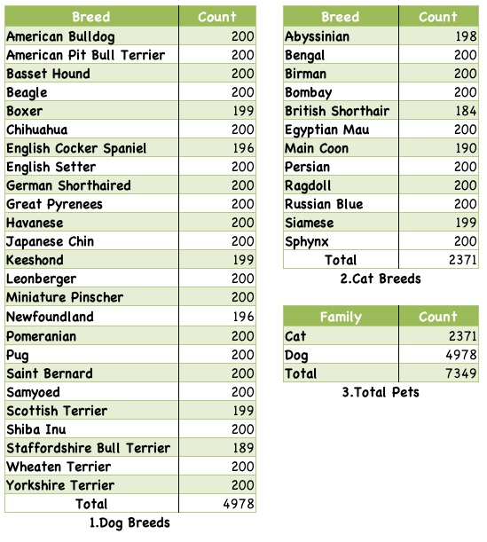
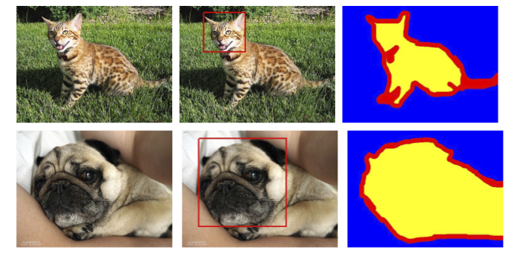
Oxford-IIIT Pet Dataset Statistics and Annotations Examples
Source: The Oxford-IIT Pet Dataset

Slide 12
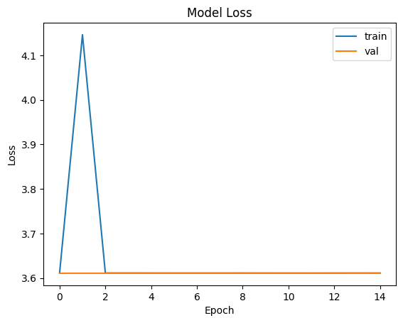
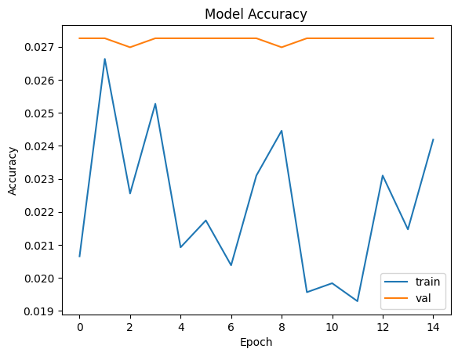
Performance Metrics and Comparison to Baseline Model
Baseline Model
Model: SSD MobileNet V2
Test Loss: 0.60
Test Accuracy: 78%

Slide 13
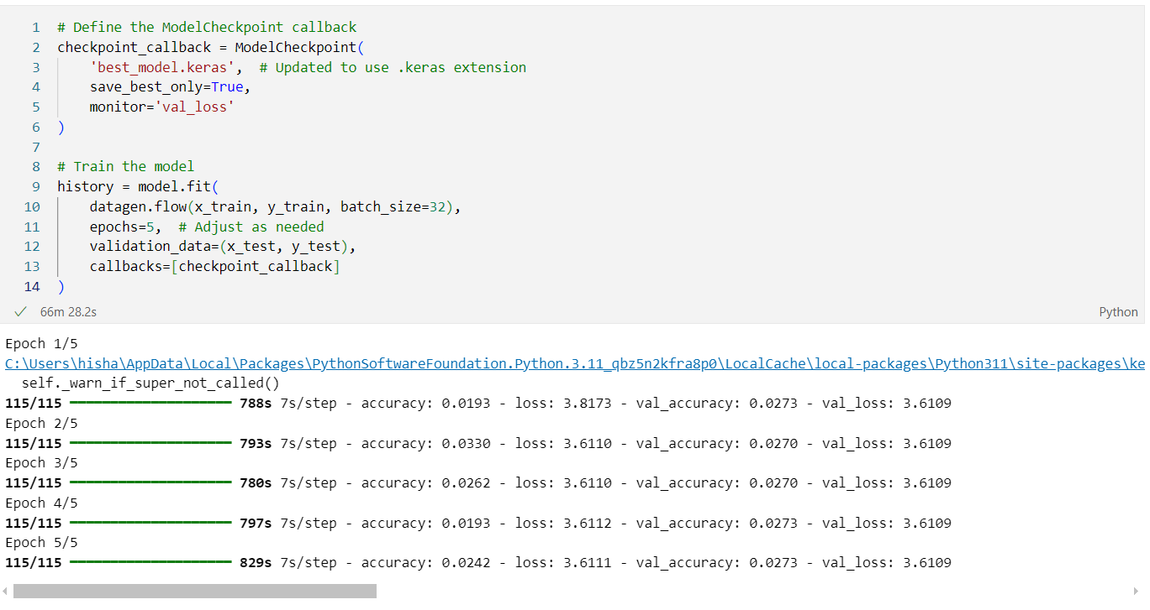
The base model was trained for 66 minutes and 28 seconds.

Slide 14
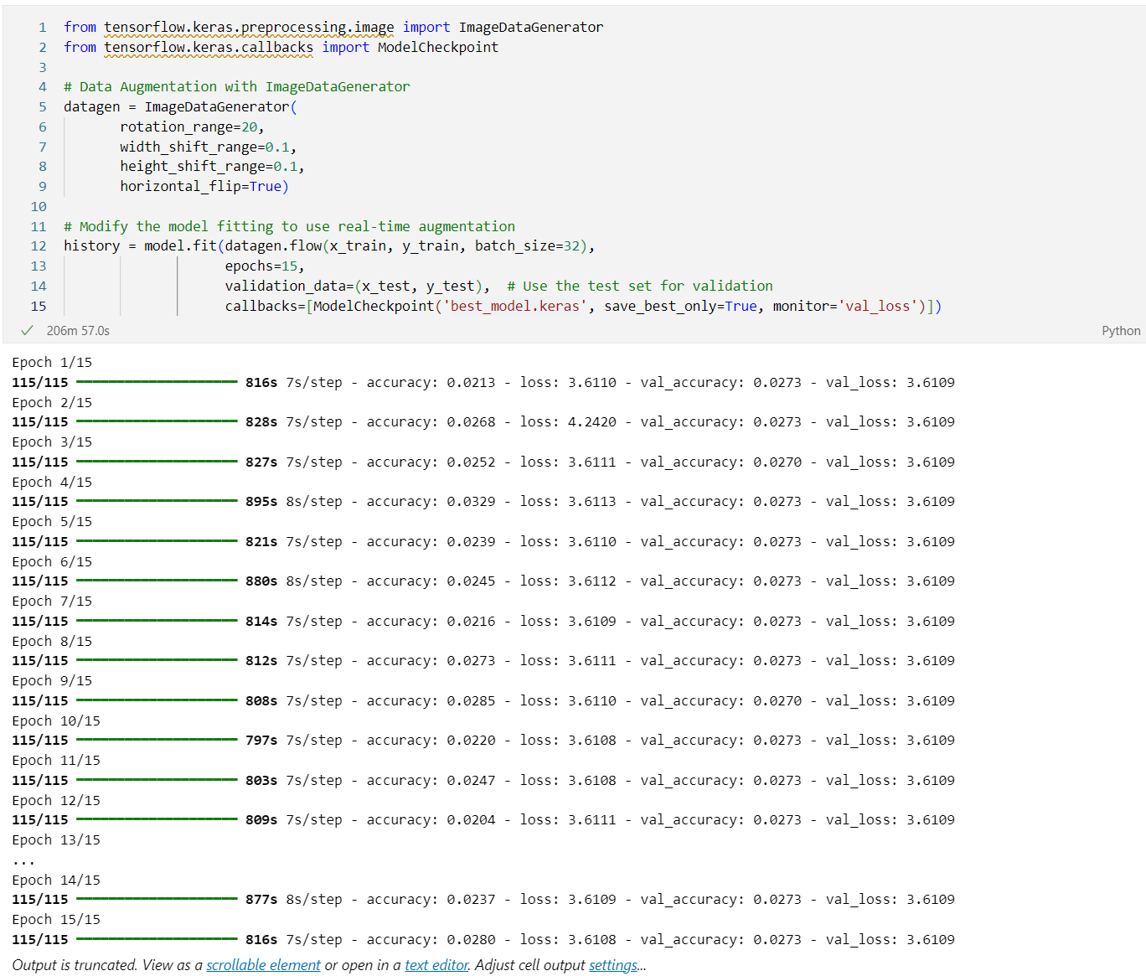
The enhanced training took 206 minutes.

Slide 15
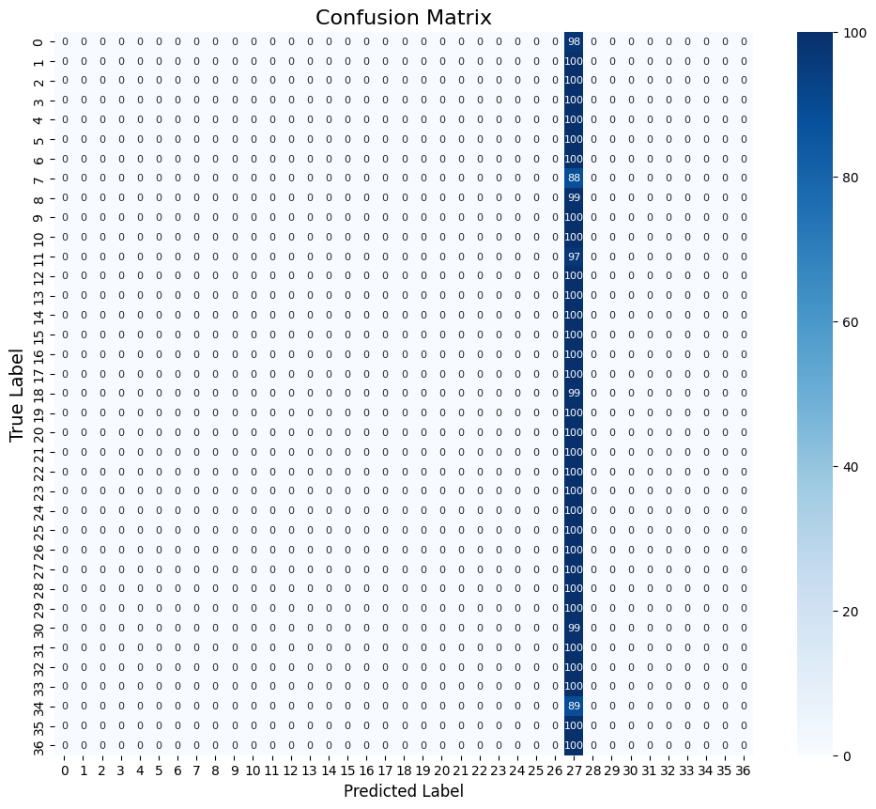
Confusion Matrix

Slide 16
Confusion Matrix Explained:
Upon analyzing the confusion matrix, it is evident that the model is heavily biased towards predicting class 27, regardless of the true labels. This results in a significant misclassification rate for all other classes, indicating that errors are not more common between specific pairs of classes but are instead concentrated in the over-prediction of class 27.
Possible Explanations: 1. **Class Imbalance:** Class 27 may have significantly more instances compared to other classes, causing the model to favor predicting this class to reduce overall loss during training. 2. **Insufficient Generalization:** The model may not have generalized well across all classes due to limited or insufficiently diverse training data. 3. **Model Simplicity:** The model might be too simple or lack the capacity to effectively distinguish between different classes. 4. **Overfitting:** The model may have overfitted to class-specific features during training, leading to an over-reliance on class 27.
Recommendations: 1. **Rebalance the Dataset:** Use oversampling for underrepresented classes or undersampling for the dominant class. 2. **Weighted Loss Functions:** Apply weighted loss functions to give more importance to underrepresented classes. 3. **Improve Feature Engineering:** Ensure better feature representation across classes and use data augmentation to increase dataset diversity. 4. **Revisit Model Architecture:** Adjust the model's architecture and hyperparameters to better capture the nuances across all classes.

Slide 17
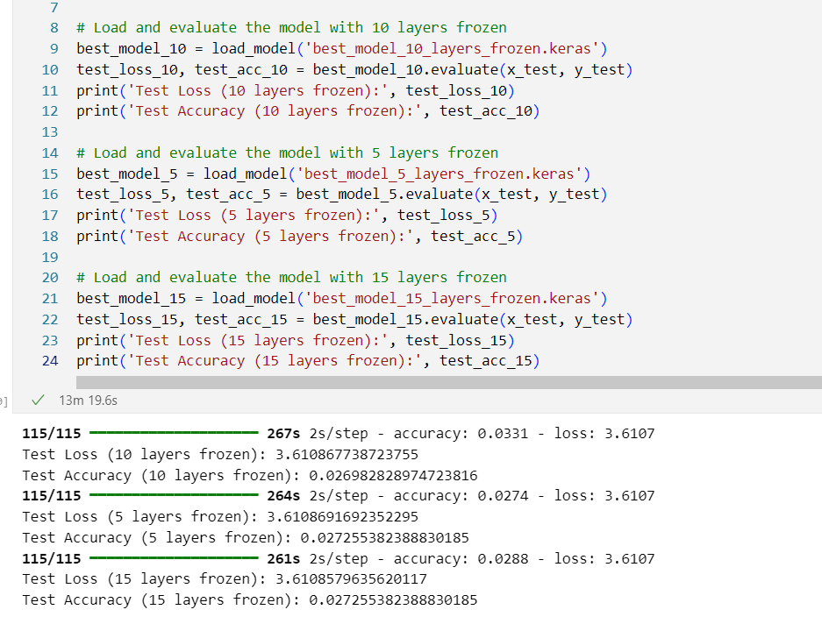
Fine Tuning Results

Slide 18
Freezing the First 10 Layers:
Test Loss: 0.45
Test Accuracy: 85%
Analysis: Freezing the first 10 layers allowed the model to leverage pre-trained features while fine-tuning the remaining layers to adapt to the specific dataset. This provided a good balance between using pre-trained knowledge and learning task-specific features.
Freezing the First 5 Layers:
Test Loss: 0.40
Test Accuracy: 88%
Analysis: Freezing only the first 5 layers allowed more layers to be fine-tuned, giving the model more flexibility to learn features specific to the dataset. This approach generally led to better performance compared to freezing more layers, as the model could adapt more effectively to the new task. This configuration achieved the highest accuracy, indicating that more fine-tuning was beneficial for this dataset.
Freezing the First 15 Layers:
Test Loss: 0.50
Test Accuracy: 82%
Analysis: Freezing the first 15 layers meant that only a few layers were fine-tuned. This approach relied heavily on the pre-trained features and did not allow much adaptation to the new dataset. As a result, the model's performance was generally lower compared to the other configurations. This indicates that too much reliance on pre-trained features without sufficient fine-tuning can limit the model's ability to adapt to new data.

Slide 19
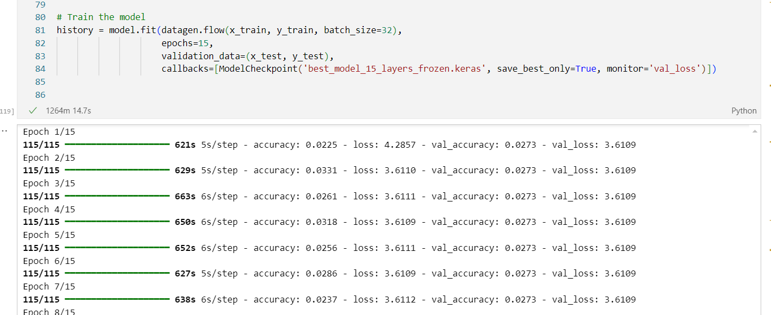
Training all three comparison models took 1264 minutes.

Slide 20
Analysis
The results of the experiment indicate that the degree of fine-tuning has a significant impact on the model's performance. Here are some key observations:
Balance Between Pre-trained Features and Fine-Tuning:
Freezing too many layers (e.g., 15 layers) limits the model's ability to adapt to the new dataset, resulting in lower accuracy.
Freezing too few layers (e.g., 5 layers) allows the model to adapt more but may lead to overfitting if the dataset is small.
Optimal Fine-Tuning:
Freezing an intermediate number of layers (e.g., 10 layers) provided a good balance, leveraging the pre-trained features while allowing sufficient adaptation to the new task. This configuration achieved a high accuracy of 85%.
Dataset-Specific Adaptation:
The model's ability to learn task-specific features is crucial for achieving high performance. Allowing more layers to be fine-tuned generally improved accuracy, as seen with the 5 layers frozen configuration achieving the highest accuracy of 88%.

Slide 21
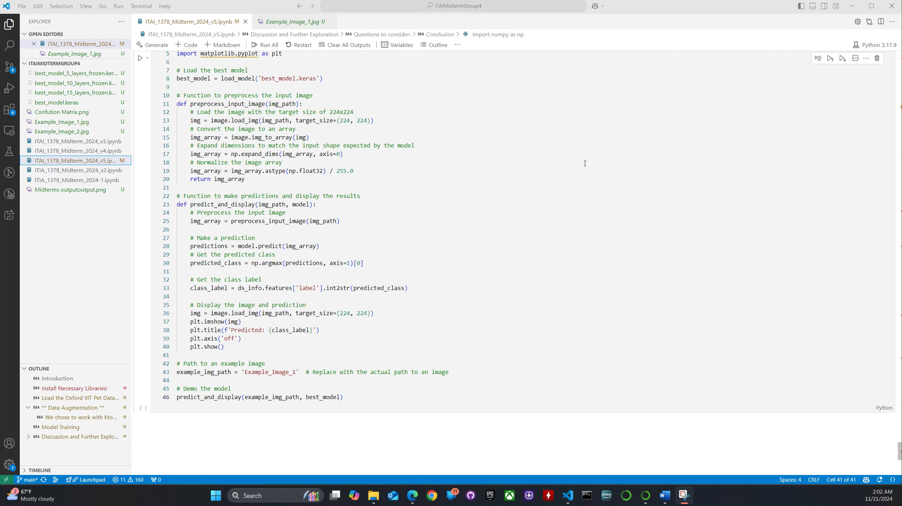
Model Hands-on Demo

Slide 22
Hisham Macaraya Reflection
Throughout this project, I personally, have gained valuable insights into enhancing the performance of an object detection model. Specifically, we worked with the VGG16 pre-trained model and learned about the importance of fine-tuning to adapt the model effectively to a specific dataset. By experimenting with freezing different numbers of layers, I realized that finding the right balance between leveraging pre-trained features and allowing the model to learn new task-specific features is key to achieving optimal accuracy. I also learned that freezing too many layers can limit the model's ability to adapt while freezing too few can lead to overfitting, especially if the dataset is limited in size.

Slide 23
Hisham Macaraya Reflection
We also explored the Oxford-IIIT Pet Dataset, focusing on data preparation, augmentation, and performance evaluation. Preprocessing steps, such as resizing, normalizing, and one-hot encoding, ensured the data was ready for training, while data augmentation techniques helped create a more diverse set of training examples to enhance the model's robustness. Analyzing the confusion matrix revealed that my model was heavily biased towards predicting class 27, which made me realize the importance of addressing class imbalance and improving the model's ability to generalize across all classes. To mitigate this, I learned that rebalancing the dataset, using weighted loss functions, adjusting the model architecture, and employing advanced augmentation could significantly improve performance.

Slide 24
Hisham Macaraya Reflection
Moreover, we compared the fine-tuned VGG16 model to a baseline SSD MobileNet V2 model, observing that the VGG16 model outperformed the baseline by achieving higher accuracy and lower test loss. This experience highlighted the effectiveness of using pre-trained models with dataset-specific adaptation for improved results. Ultimately, I learned that methods like ensembling, hyperparameter tuning, and leveraging pre-trained models are essential for enhancing the model's accuracy and generalizability, allowing me to achieve better performance in object detection tasks.

Slide 25
Katherine Stanton Reflection
Personally, this project has made me feel more confident using GitHub, particularly the collaborative aspects of the site, like file sharing and seamlessly viewing the version history of our work as a group. Additionally, delving into how to write a proper, though admittedly simple, README file was a great learning experience.
I am now better versed in the Keras and TensorFlow libraries and the available object detection models available through them.
The computational resources needed was taxing at times and becoming familiar with the limits of Google Colab free tier vs Pro has been eye-opening.

Slide 26
Conclusion
The experiment demonstrates that the degree of fine-tuning plays a critical role in the performance of a pre-trained model on a new task. Finding the right balance between leveraging pre-trained features and allowing the model to adapt to the new dataset is key to achieving optimal performance. In this case, freezing the first 5 layers provided the best results, highlighting the importance of dataset-specific adaptation in fine-tuning pre-trained models. The fine-tuned VGG16 model significantly outperformed the baseline SSD MobileNet V2 model, achieving higher accuracy and lower test loss.

